Slide 1
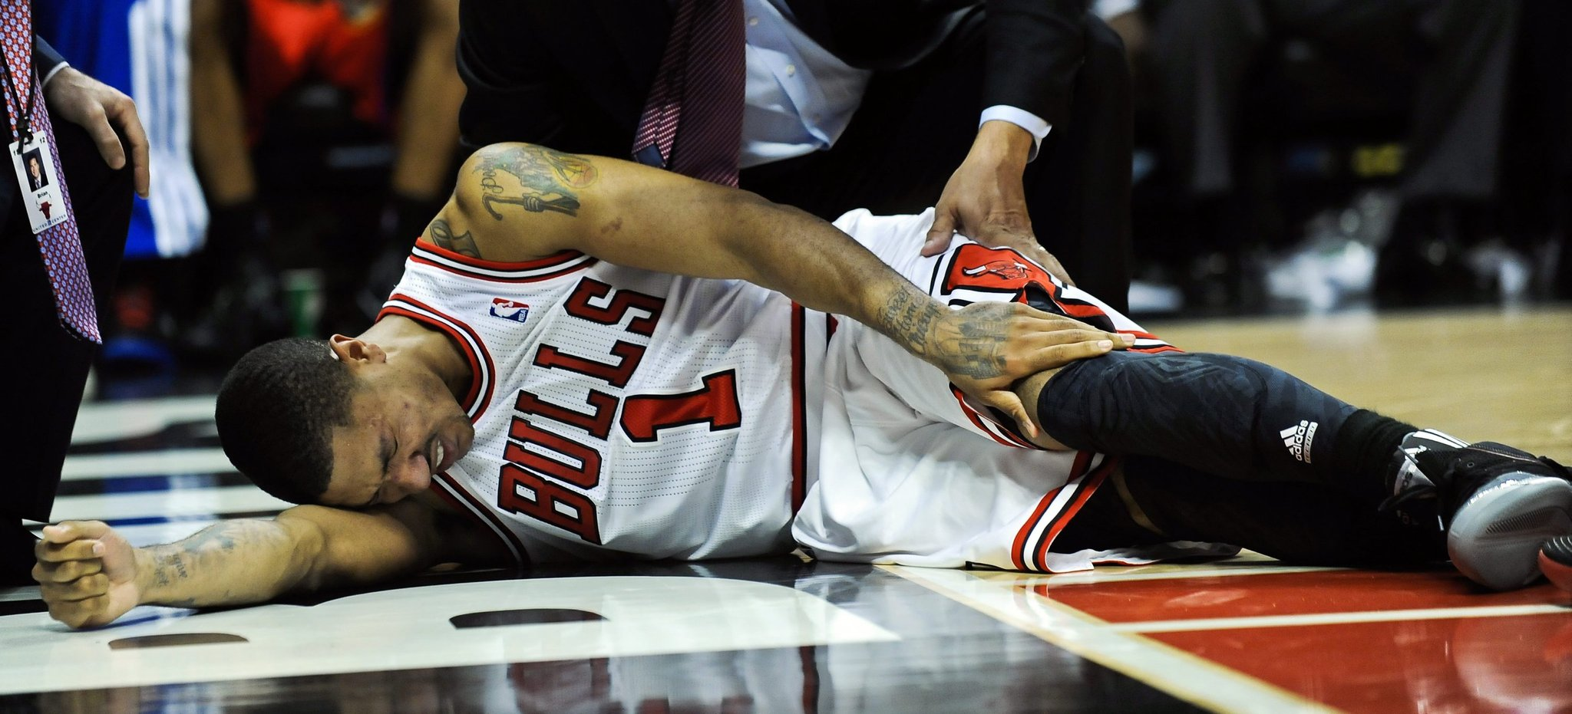
NBA Injuries
Matt Davis
Yannick Befidi
Jake Clauson
Bryce Jones

Slide 2

Thesis, Definitions and Questions
Definitions:
NBA Schedule: The NBA schedule runs from October until April for regular season and April to June for post-season
Load Management: Load management is about balancing the risk for injury with long-term performance.
Injury: Any ailment or condition that prevents a player from playing in a game
Questions:
How many injuries occur per season between 2001-present?
What months/years do players get hurt the most?
What are the most common injuries in the NBA?
Hypothesis: Do injuries affect players in the NBA?

Slide 3
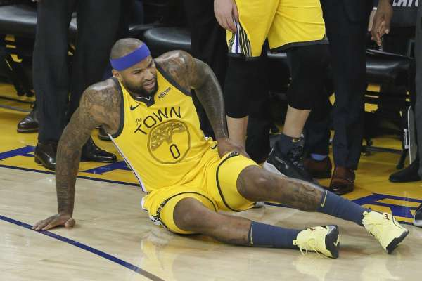
How many injuries occur per season between 2000-present?

Slide 4
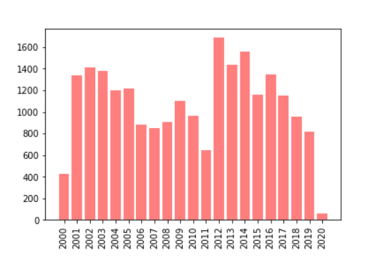
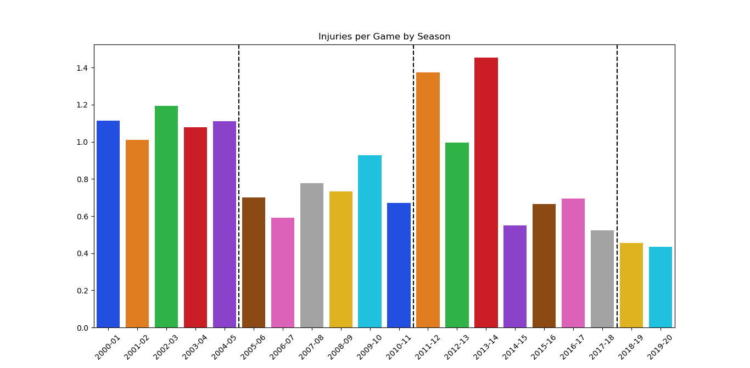
What seasons/years did players get hurt the most?
Max Year (2013-2014)
Number of Injuries
Exact Year of Injuries
The most amount of injuries occurred during the 2012 year.
The most injuries during the regular season occurred during 2013-2014 season

Slide 5
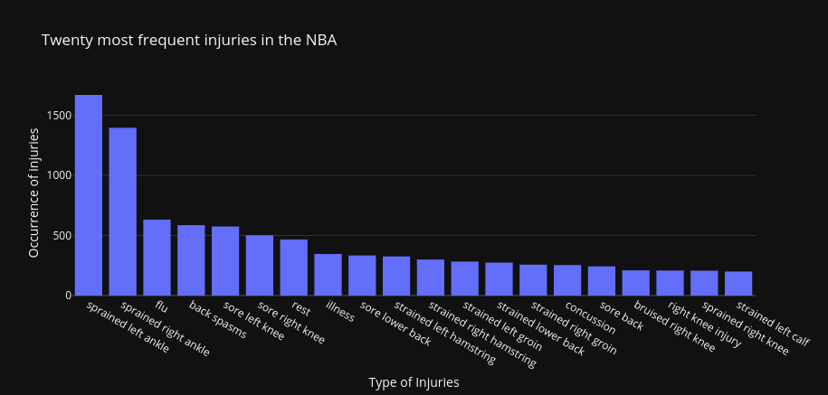
What are the most common injuries in the NBA?
Sprained ankles are the predominant injuries in the NBA
Interestingly, the right sprained knee and left calf are the lowest injuries
“Rest” was considered a major reason for missed time during a season
“Illness” was also a major factor in players missing time

Slide 6
Questions?

